Slide 1
Put all your energy in to sand
Invest in 100% clean energy

Slide 2
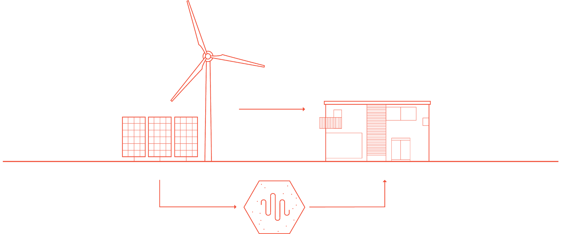
How it works
ENERGY
CONSUMPTION
electricity
excess energy
heat
STORAGE

Slide 3
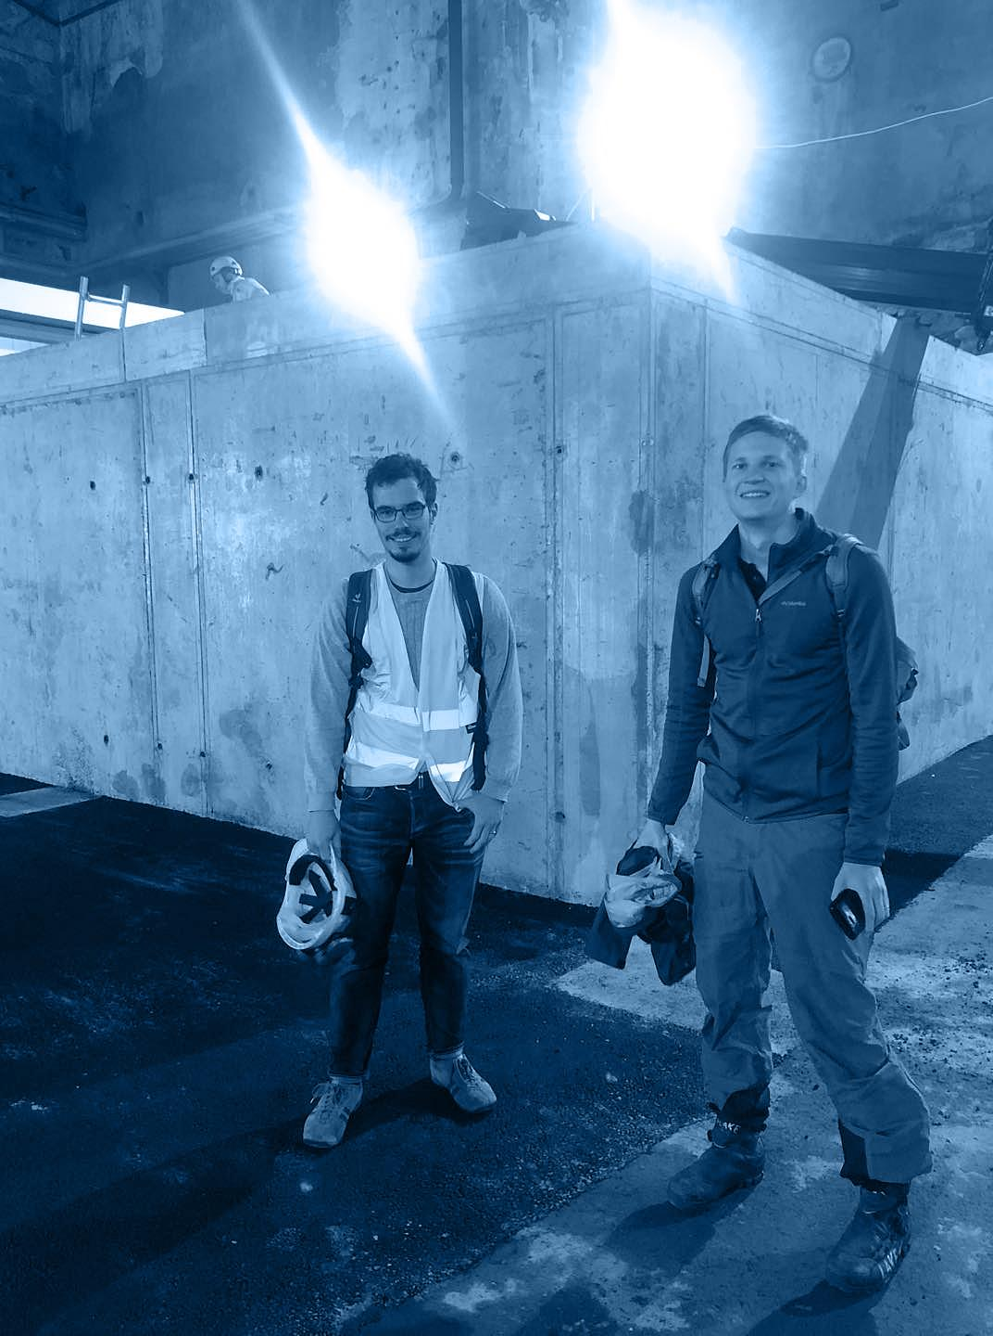
Our story: The hippie
commune for engineers
Two young men were running a thought experiment over coffee at Tampere University on 13 April 2012. Energy Technology students Tommi and Markku were challenging each other: Is it possible to build an energy self-sufficient and cost effective “hippie commune for engineers” using only solar power? The joke turned into Tommi’s MSc thesis of energy storage solutions and Markku’s PhD on hydraulic turbine monitoring.
Eight years later the friends are standing next to their pilot plant that is connected to the district heating network of the City of Tampere. This solution can provide stable, affordable, clean energy to New York as well as to the distant village of Näkkäläjärvi.

Slide 4
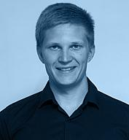
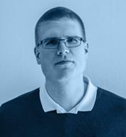
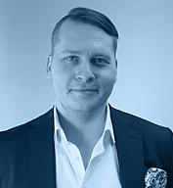
Team
Operational
Advisory
Tommi Eronen
CEO
MSc in Power
Plant Engineering
Markku Ylönen
CTO
DSc in Applied
Mechanics
Mika Rautiainen
Head of Sales
Industrial Business
Professional
Liisa Naskali Project Manager
MSc Advanced Engineering Physics
Ville Kivioja
Computational Physics Modeller
Mathematics PhD Student
Mikko Paananen
Business Relations
Serial Entrepreneur
Jussi Muurikainen
Investor Relations
Serial Entrepreneur
Business Developer
Expert in Creating Success
Brand & Communications
Expert in Creating Company Image

Slide 5
Vision: Cut Emissions,
Revolutionise Energy Markets
Patented solution: store wind and solar power as heat in sand
Electricity for users, excess energy into heat, used later during the year
Affordable, safe, scalable, and reliable around the world
Unit sizes: home, industrial complex, housing district

Slide 6
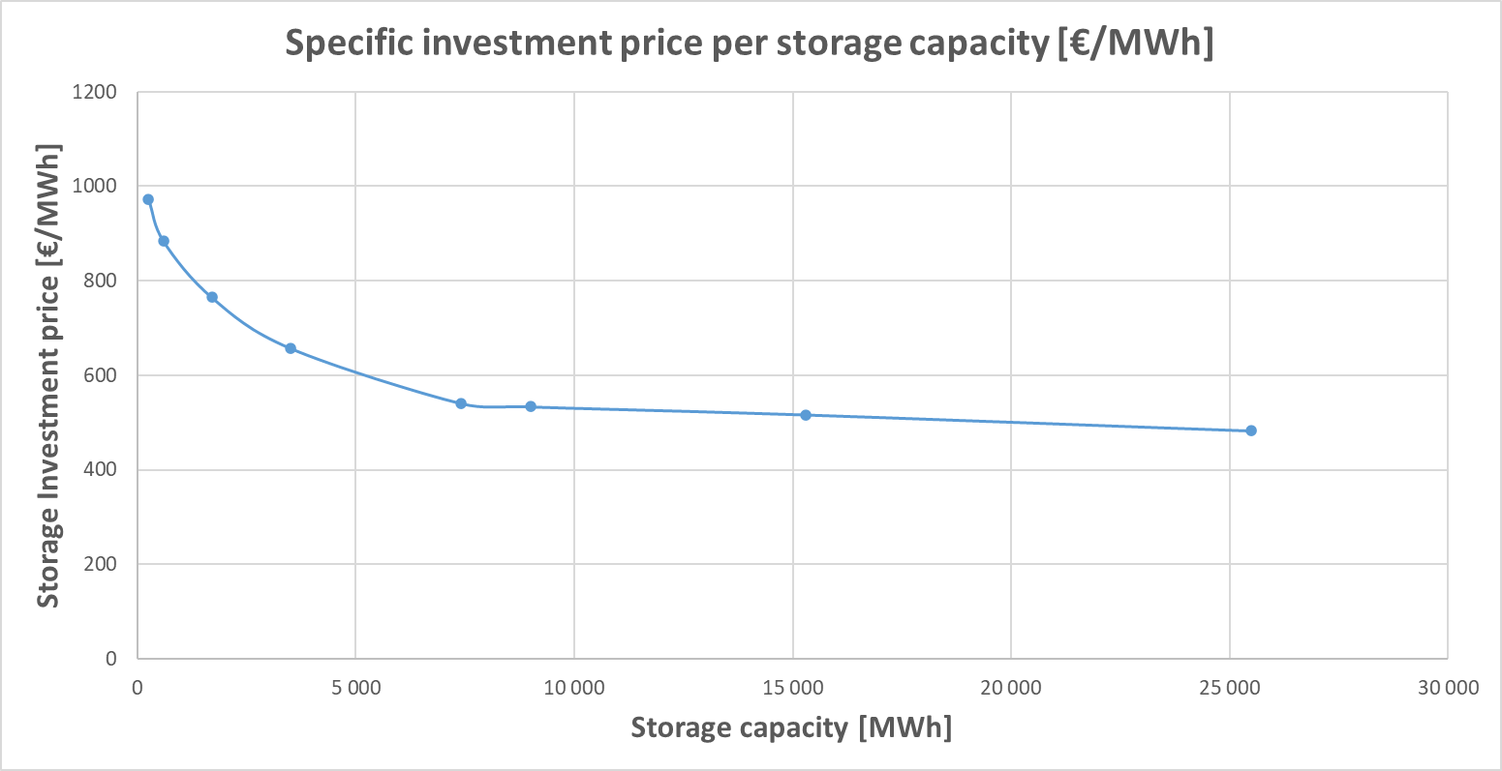
Large Energy Storages in Hiedanranta: Economy
The investments for the storage are relatively low – it enables flexible connection of the electricity and heat sectors:
Average electricity price: 21 €/MWh
Electricity transfer: 7 €/MWh
Investment: electricity connection 0.6 €/MWh
Investment: heating network 3.1 €/MWh
Investment: heat storage 6.1 €/MWh
Pre-tax sum: 37.1 €/MWh
Electricity tax, industry: 5 €/MWh
Electricity tax, general: 22.5 €/MWh
Total heat price: 37.1 to 59.6 €/MWh
Storage specific investment price reduces and then settles to relatively constant level

Slide 7
Better Energy Systems
Simple design – reliable globally and easily implemented
IDA ICE compatible – design buildings with storages
High volumetric capacity
Efficient emission reductions
SUMMER
WINTER
Energy Companies
Notes:
Markku

Slide 8
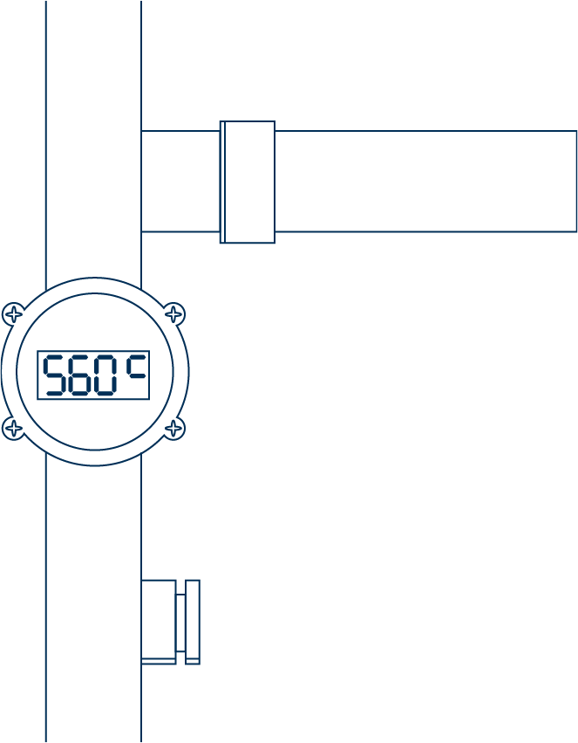
Better Profits by Better Energy
Stable product prices
Fixed energy prices for 30 years and beyond
Optimal process temperatures
High storage temperature allows flexible operation
Sand as storage medium
Clean, non-toxic and environmentally friendly
Allows high storage temperatures
Optimal for seasonal heat storages
Low thermal conductivity and low heat losses
Minimal land usage
Allows construction on-top in high valued city spaces
Industry
Notes:
Markku

Slide 9
Hot sand. Do you dig it?
Tommi Eronen +358 45 7831 5988
tommi.eronen@pne.fi
www.polarnightenergy.fi

